Slide 1
Confirmation Meeting
Wednesday 13th March 2024

Slide 2
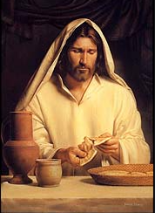
The Lord’s Supper

Slide 3
Commitment Promises
How are you doing?
Task: Take a few moments with your parents to reflect on the Commitment Promises you made a few months ago.
Did you promise to:
say more prayers
attend Mass more often
read more Bible stories
learn about the lives of Saints so you can choose a Saint to inspire you
care for a relative or neighbour by doing acts of kindness
Do you need to work on your promises between
now and when you are Confirmed?
Is there anything extra you can do to become closer to
God in the next few weeks?

Slide 4
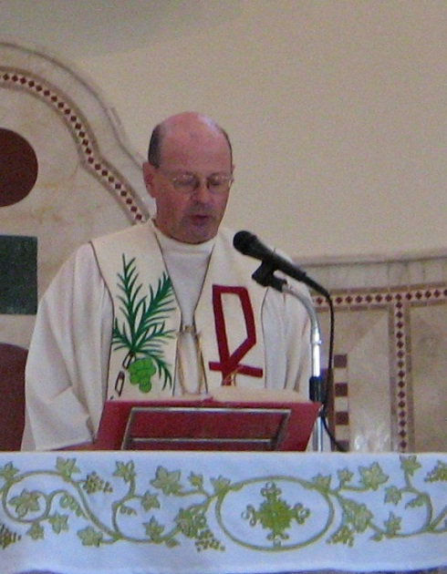
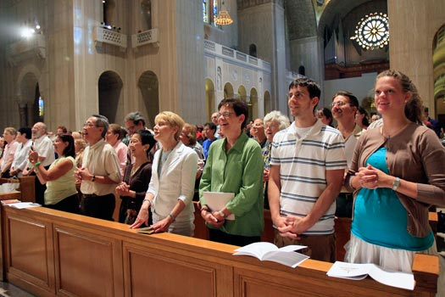
Introductory rite
CELEBRATING THE MASS
INTRODUCTORY RITE
Notes:
We begin our celebration with the INTRODUCTORY RITE. The following 5 slides are about what we do in this introductory part.

Slide 5
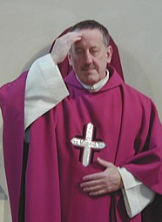
The sign of the cross
CELEBRATING THE MASS
INTRODUCTORY RITE
Notes:
We start by making the sign of the cross. This is led by the priest, a very special person: the celebrant. We all make the sign of the cross with him as he calls the names of the Father, the Son and the Holy Spirit. Together well all then answer our AMEN.

Slide 6

The penitential rite
CELEBRATING THE MASS
INTRODUCTORY RITE
Through my fault, through my most grievous fault
We show how sorry we are for our sins.
I confess …
Lord have mercy…
Notes:
At the PENITENTIAL RITE we think of our sins and CONFESS before God and everyone gathered that we failed in different ways (thoughts, words, deeds) and we show we are sorry. We ask God’s Mercy and we also ask all others gathered in church to pray for us.

Slide 7
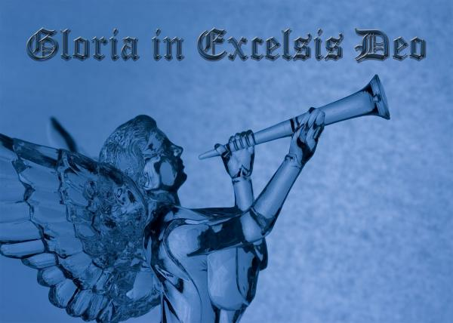
The gloria
CELEBRATING THE MASS
INTRODUCTORY RITE
Praising God:
Father, Son and Holy Spirit
Notes:
The GLORIA is a prayer of praise to God. We praise him and give him glory to honour him and acknowledge how great he is. We also praise him for all that he does for us or has given us.

Slide 8
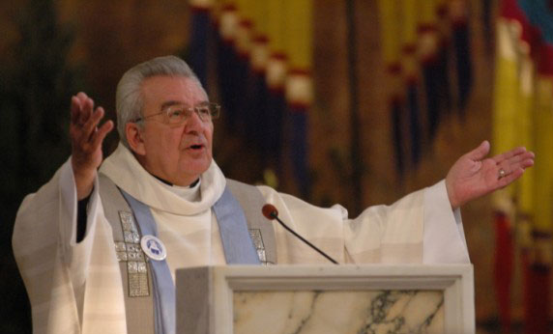
Opening prayer
CELEBRATING THE MASS
INTRODUCTORY RITE
The Priest puts all our prayers before God.
Notes:
The OPENING PRAYER is a short prayer which concludes this first part of the Liturgy of the Mass. It is read by the priest and it is usually related to the readings and the main theme of the celebration of that mass whether it is a Sunday or any other day. This opening prayer is sometimes also called ‘The Collect’ prayer.

Slide 9
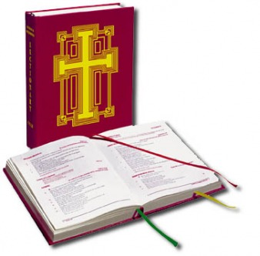
Liturgy of the word
CELEBRATING THE MASS
THE LITURGY OF THE WORD
Listening to the Word of God
Notes:
The LITURGY OF THE WORD is the first main part of the Mass and comes after the Introductory Rite. We now sit to LISTEN to God’s word through readings from different parts of the Bible. The coming slides look at each of these readings etc.

Slide 10
CELEBRATING THE MASS
THE LITURGY OF THE WORD
TASK: Parents and children discuss which parts of the Bible do the following parts of the Liturgy of the Word come from…
First Reading:
Psalm:
2nd Reading:
Gospel:
Notes:
The LITURGY OF THE WORD is the first main part of the Mass and comes after the Introductory Rite. We now sit to LISTEN to God’s word through readings from different parts of the Bible. The coming slides look at each of these readings etc.

Slide 11
CELEBRATING THE MASS
THE LITURGY OF THE WORD
First Reading: Old Testament
Psalm: 2nd Reading: New Testament
Gospel: New Testament
Notes:
The LITURGY OF THE WORD is the first main part of the Mass and comes after the Introductory Rite. We now sit to LISTEN to God’s word through readings from different parts of the Bible. The coming slides look at each of these readings etc.

Slide 12
CELEBRATING THE MASS
THE LITURGY OF THE WORD
TASK:
What are the responses to these readings…
First and Second Reading…
The reader says: The Word of the Lord
R: Thanks be to God
Notes:
The LITURGY OF THE WORD is the first main part of the Mass and comes after the Introductory Rite. We now sit to LISTEN to God’s word through readings from different parts of the Bible. The coming slides look at each of these readings etc.

Slide 13
CELEBRATING THE MASS
THE LITURGY OF THE WORD
TASK:
To introduce the Gospel, Father will say
The Lord be with you
And with your Spirit
A reading from the Holy Gospel according to…
What words and actions do we do and say?
Glory to you, O Lord
(We use our right thumb to trace the sign of the cross on our
foreheads, lips and heart)
Notes:
The LITURGY OF THE WORD is the first main part of the Mass and comes after the Introductory Rite. We now sit to LISTEN to God’s word through readings from different parts of the Bible. The coming slides look at each of these readings etc.

Slide 14
CELEBRATING THE MASS
THE LITURGY OF THE WORD
To finish the Gospel, Father will say
The Gospel of the Lord
How do we respond?
Praise to you, Lord Jesus Christ
Notes:
The LITURGY OF THE WORD is the first main part of the Mass and comes after the Introductory Rite. We now sit to LISTEN to God’s word through readings from different parts of the Bible. The coming slides look at each of these readings etc.

Slide 15
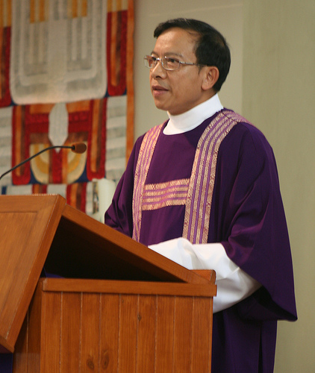
The homily
CELEBRATING THE MASS
THE LITURGY OF THE WORD
The Priest talks about the Readings of the day and the main message in them.
Notes:
After the reading of the Gospel we sit and listen to the Priest talking to us. This is called the HOMILY. The priest talks about the readings of the day and the main message in them. He helps us to reflect about how to put what God says in the Bible readings into our day to day life.

Slide 16
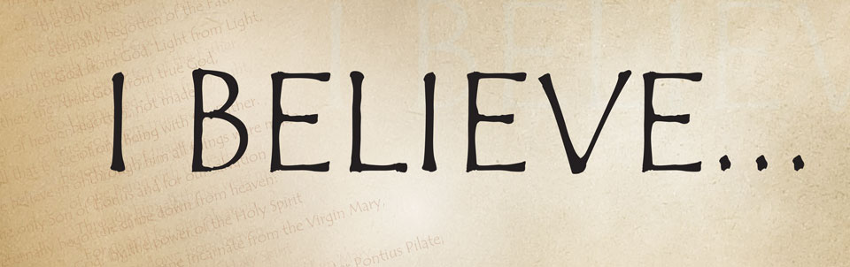
The creed
CELEBRATING THE MASS
THE LITURGY OF THE WORD
We profess our FAITH
We say what we BELIEVE in
Notes:
After the Homily we all stand to recite the CREED. This is statement of Faith. In it we say and profess in front of the whole community gathered in church what we BELIEVE in: One God, Father, Son, Holy Spirit, Everlasting life, forgiveness of sins, etc.

Slide 17
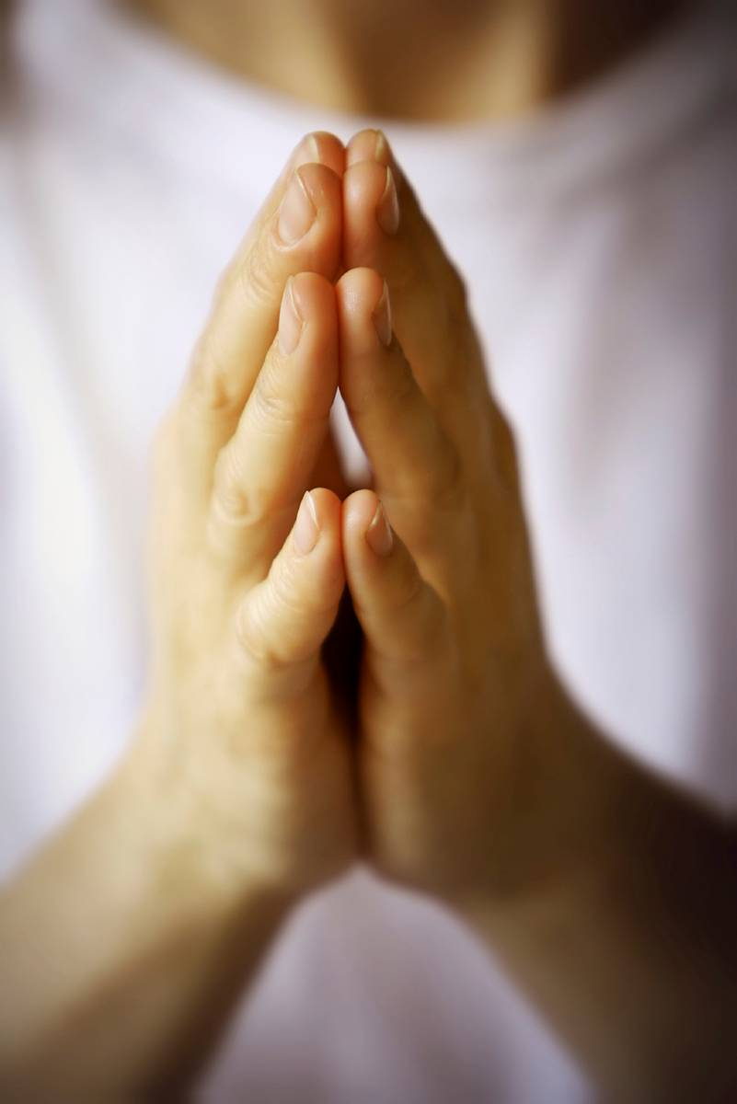
Bidding prayers
CELEBRATING THE MASS
THE LITURGY OF THE WORD
We pray for the Needs of the Church, our own needs and others who need God’s help.
Notes:
This is the last part of the LITURGY OF THE WORD. Sometimes these BIDDING PRAYERS are also called the PRAYERS OF THE FAITHFUL. We pray for our needs, the needs of the Church, our parish and anyone else who need God’s help. There is a response at the end of each prayer e.g. Lord graciously hear us; or Hear our prayer etc.

Slide 18
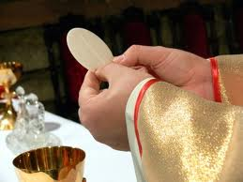
The liturgy of the eucharist
CELEBRATING THE MASS
THE LITURGY OF THE EUCHARIST
Sharing the Bread and Wine
Receiving the Body of Christ
Notes:
The LITURGY OF THE EUCHARIST is the second main part of the celebration following the LITURGY OF THE WORD. It therefore focuses on the Eucharist itself: the Body and Blood of Christ. The following slides look at what we do in this part of the Mass.

Slide 19
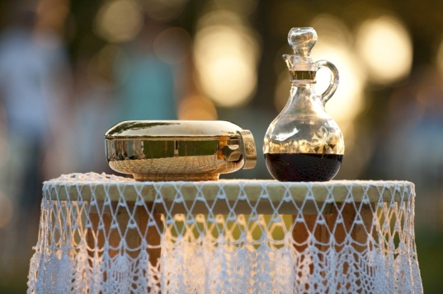
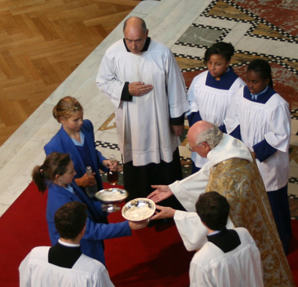
The offertory
CELEBRATING THE MASS
THE LITURGY OF THE EUCHARIST
We offer Bread and Wine
We offer ourselves to God
Notes:
This section begins with the OFFERTORY. We often bread and wine which are carried along to be presented to the priest. These are the two things Jesus chose and used at the Last supper when he celebrated the Eucharist for the first time. At the same time we understand that we are offering ourselves to God. At this time a collection is usually taken at Sunday masses for the needs of the Church and the Parish. This is also part of our offertory.

Slide 20
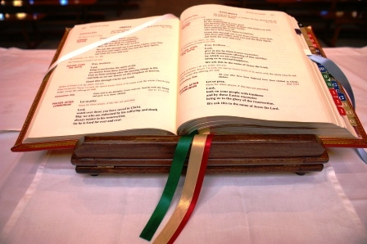
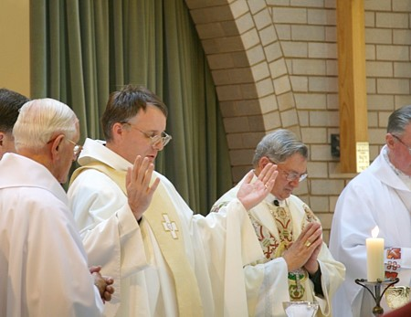
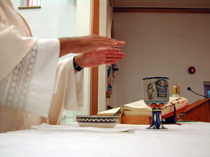
The Eucharistic prayer
CELEBRATING THE MASS
THE LITURGY OF THE EUCHARIST
Eucharist Prayer: Eucharist means THANKSGIVING. The Priest thanks and praises God for all his goodness towards us. During this prayer, JESUS will become PRESENT among us.
Notes:
Following the Offertory the priest leads us through the EUCHARISTIC PRAYER. Eucharist means Thanksgiving. In this prayer the priest thanks and praises God for all his goodness towards us and later on says the important words that make the bread and wine become the body and blood of Jesus. There different versions of the Eucharistic prayer but each of them have responses to be said by people in the congregation too eg. It is right and just etc…

Slide 21
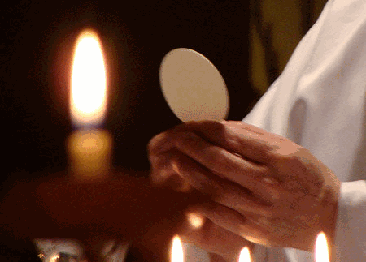
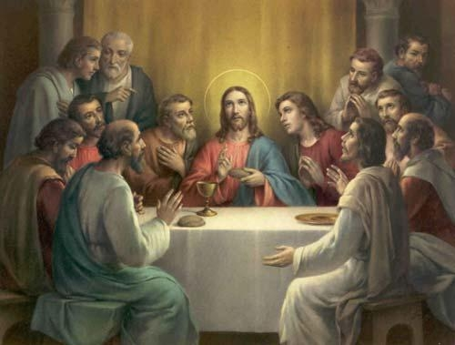
consecration
CELEBRATING THE MASS
THE LITURGY OF THE EUCHARIST
Task: Discuss with your parents why and when bells ring during this part of the Eucharistic Prayer.
When the bread becomes the BODY OF CHRIST.
When the wine becomes the BLOOD of Christ.
Notes:
At this special moment of CONSECRATION the priest repeats the words Jesus used at the Last supper and consecrates the bread and wine which from that moment onwards become the BODY and BLOOD of Christ.

Slide 22
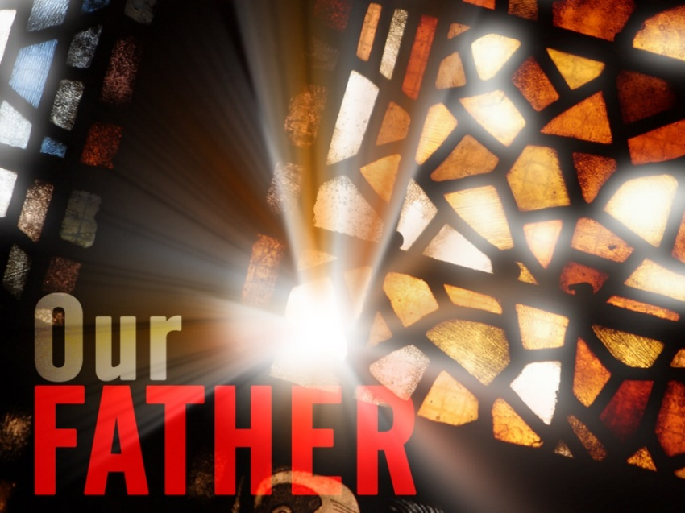
The our father
CELEBRATING THE MASS
THE COMMUNION RITE
We PRAISE God.
We ask him to FORGIVE us.
We ask him to HELP us in all our needs.
Notes:
The Priest invites us to recite together the OUR FATHER which is the prayer Jesus himself taught us. In it we Praise God’s name, we ask him to forgive us our trespasses, we ask him to give us our daily bread and all we need, we ask him to lead us away from temptation and deliver us from evil.

Slide 23

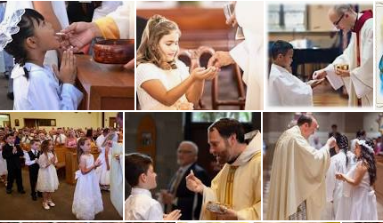
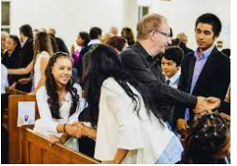
Communion rite
CELEBRATING THE MASS
THE COMMUNION RITE
Notes:
The Priest invites us to recite together the OUR FATHER which is the prayer Jesus himself taught us. In it we Praise God’s name, we ask him to forgive us our trespasses, we ask him to give us our daily bread and all we need, we ask him to lead us away from temptation and deliver us from evil.

Slide 24
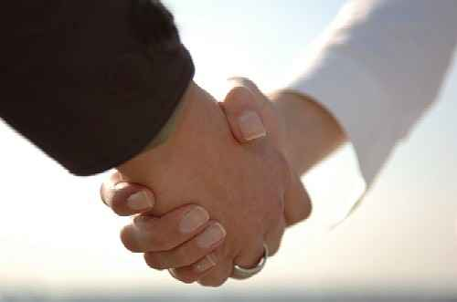
Sharing the peace
CELEBRATING THE MASS
THE COMMUNION RITE
We share the SIGN of PEACE.
We show we love everyone.
Notes:
The priest invites us to share peace with others gathered with us for the celebration of the Mass. We share peace to show we love and respect everyone else without exception.

Slide 25
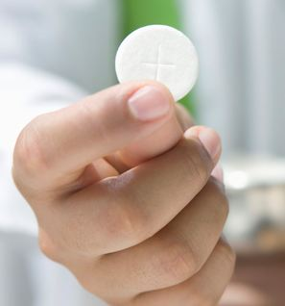
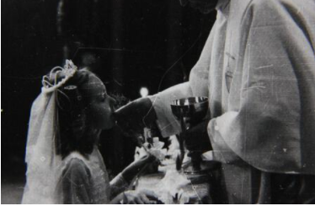
Holy communion
CELEBRATING THE MASS
THE LITURGY OF THE EUCHARIST
We receive the Body and Blood of Christ
Notes:
We are then invited to receive Holy Communion. We walk towards the priest or Eucharistic minister who shows us the Eucharist while saying ‘the body of Christ’. We respond by saying AMEN showing that we agree and believe that we are receiving the Body of Christ. (You may also wish to talk about receiving communion on the tongue or in the hand by talking about the way this should be done). Sometimes we also have the opportunity to drink the Blood of Christ.

Slide 26
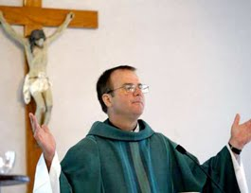
conclusion
CELEBRATING THE MASS
CONCLUDING RITE
Prayer after Communion
P:The Lord be with you.
R: And with your spirit.
P: May almighty God bless you, the Father, and the Son, and the Holy Spirit.
R: Amen.
P: Go in peace.
R:Thanks be to God.
Congregation remain standing until Priest has left and final hymn has been sung.
Notes:
After communion the priest invites us to stand for the last short part of the celebration of the Eucharist.
A Prayer after communion is read which is again different for every mass.

Slide 27
Sacramental Programme
Between now and the next meeting …
Parents’ Task
Please try to:
Fulfil the promises you made together
Pray with your children
Read Bible stories together
Try to go to more Masses with your child
  Share the experience together
  Pick out the different parts of Mass
  Learn some of the Mass responses
  Model how to act with reverence during Mass
  Discuss the true meaning of receiving the Eucharist.
  Discuss the meaning of receiving the gifts of the Holy Spirit.

Slide 28
Local Sunday Mass Times
Our Lady & St. Benedict – Saturday 5pm.
St. George & St. Martin’s – Sunday 9:30am
Sacred Heart Hanley
Saturday – 12:05pm.
Sunday – 9am & 11am.

Slide 29
Sacramental Preparation
Sunday 26.11.23 9:30 a.m. | Family Mass for Y3 and Y6 Y3 to lead : Enrolment for Sacraments
Weds 10.1.24 6pm | Meeting for Y6 Parents and Children Commitment to Confirmation
Sunday 21.1.24 9:30am | Family Mass for Y6 andY3 Y6 to lead: Commitment for Confirmation
Wednesday 13.3.24 6pm | Meeting for Y6 parents and children Parts of the mass
Sunday 17.3.24 9:30am | Family Mass for Y3 and Y6 Y3 to lead – Thanksgiving for Reconciliation
Sunday 21.4.24 9:30am | Family Mass for Y3 and Y6
Weds 8.5.24 6pm | Meeting for Y6 Parents and Children Fruits and Gifts of the Holy Spirit
Weds 5.6.24 6pm | Meeting for Y6 Parents and Children Service of Light – Rite of Confirmation
Sunday 9.6.24 9:30am | Y6 and Y3 Family Mass: Y6 to lead Service of Light and Corpus Christi
Thursday 20.6.24 7pm | Y6 Confirmation Mass

Slide 30

Prayer to the Holy Spirit
Prayer of the Holy Spirit
Come Holy Spirit,
Fill the hearts of your faithful,
And kindle in them the fire of your love,
Send forth your spirit and they shall be created,
And you will renew the face of the earth.
O God who instructed the hearts of the faithful,
By the light of the Holy Spirit,
Grant that by the gift of that same spirit,
We may be always truly wise and ever rejoice in his Consolation.
Through Christ Jesus our Lord,
Amen

