Slide 1

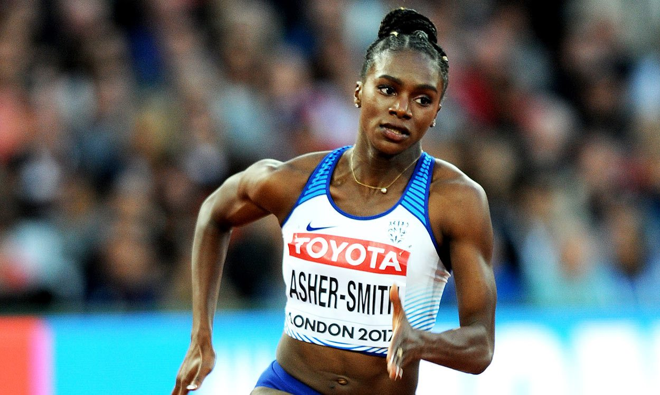
Train like Dina Asher-Smith!
Sprinters need their muscles to work in short, sharp, explosive bursts!
For one Asher-Smith Newman point you will need to complete this workout:
10 seconds sprinting as fast as you can, 30 seconds walking,
10 seconds sprinting as fast as you can, 30 seconds walking.

Slide 2
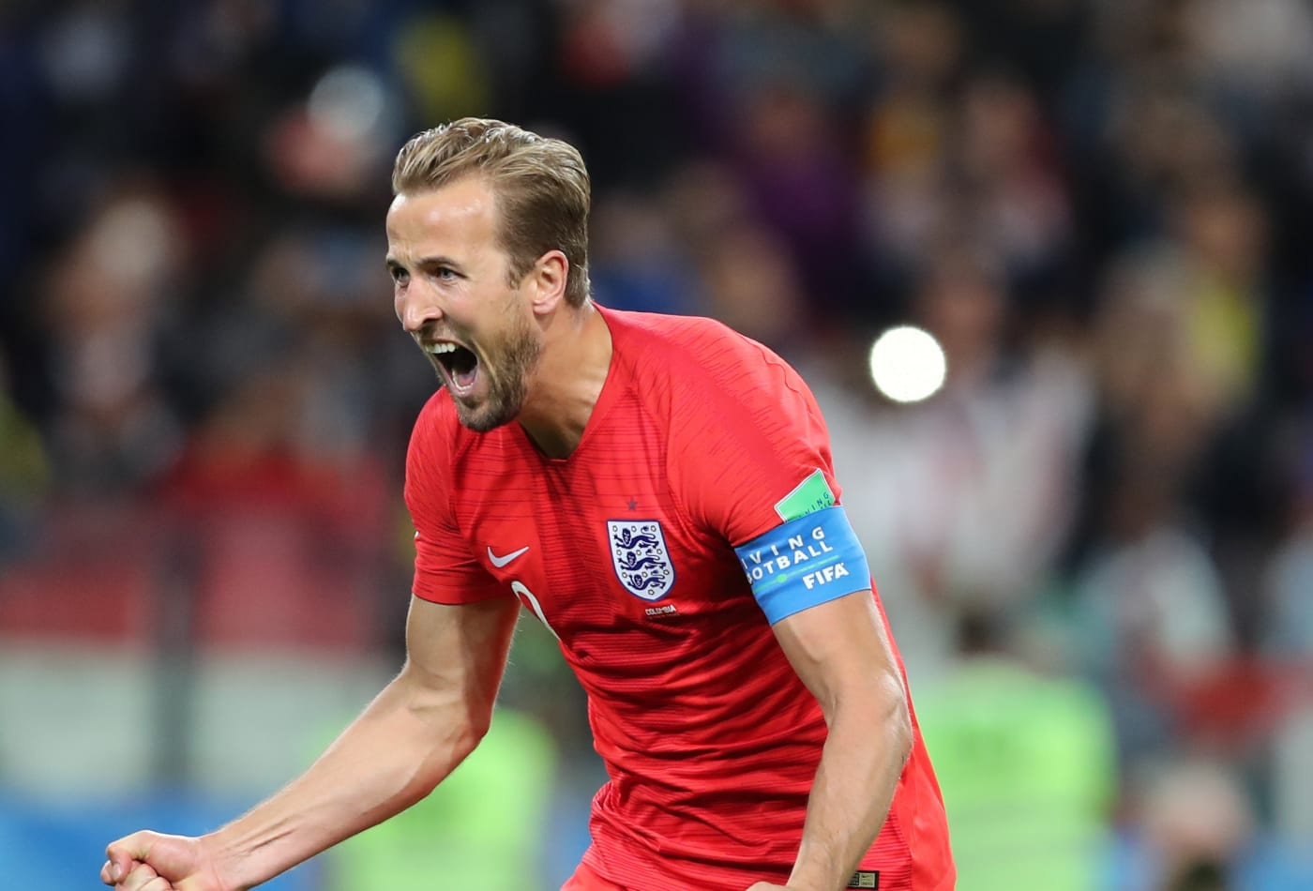
Train like Harry Kane!
Football players need their bodies to be agile and to work hard for a long time!
For one Kane Newman point you will need to complete this workout:
Continuous running for 1 minute, 10 Space Rockets
Continuous running for 1 minute, 10 Space Rockets

Slide 3
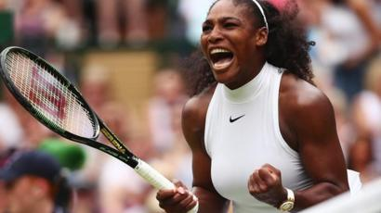
Train like Serena Williams!
Tennis players need their bodies to be agile and strong !
For one Williams Newman point you will need to complete this workout:
2 shuttle sprints, 10 Star Jumps, 10 Squats
2 shuttle sprints, 10 Star Jumps, 10 Squats

Slide 4
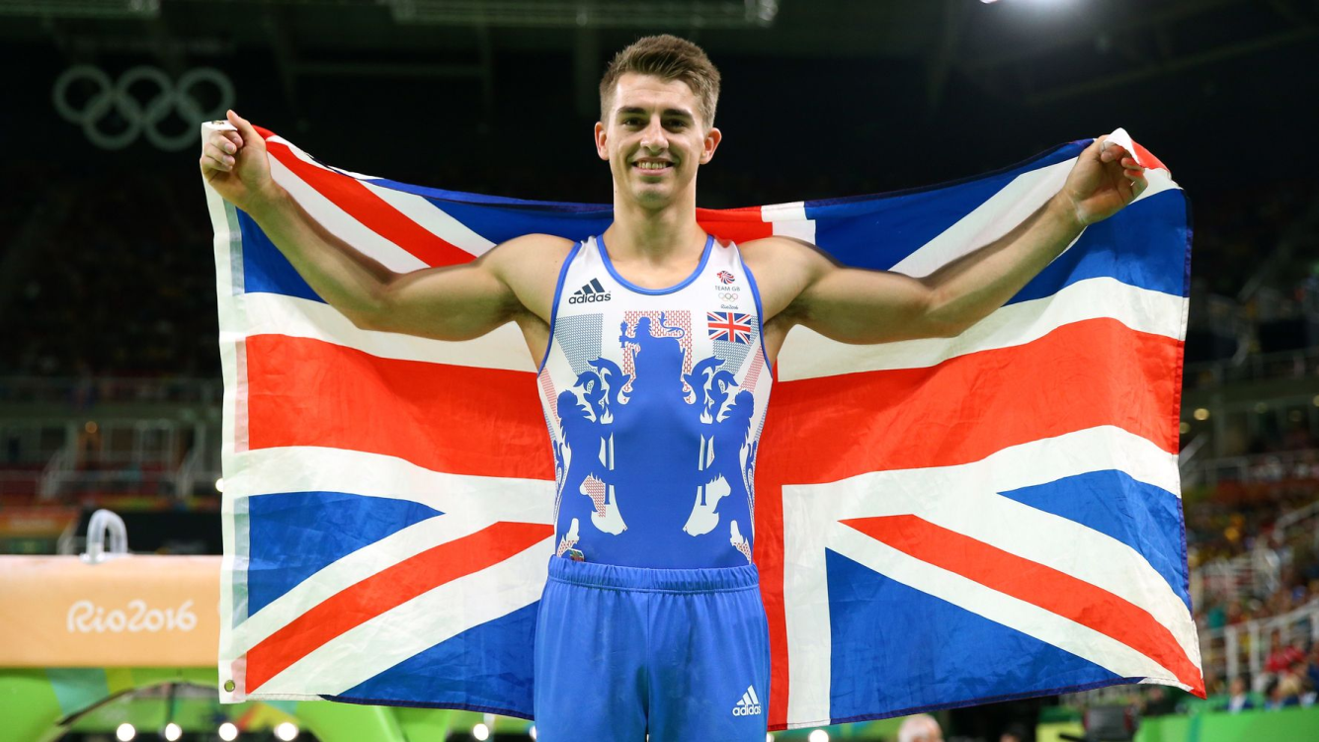
Train like Max Whitlock!
Gymnasts need their bodies to be flexible and strong!
For one Whitlock Newman point you will need to complete this workout:
4 point balance for 5 seconds, 3 point balance for 5 seconds, 15 Shoulder touch press ups, 2 point balance for 5 seconds

Slide 5
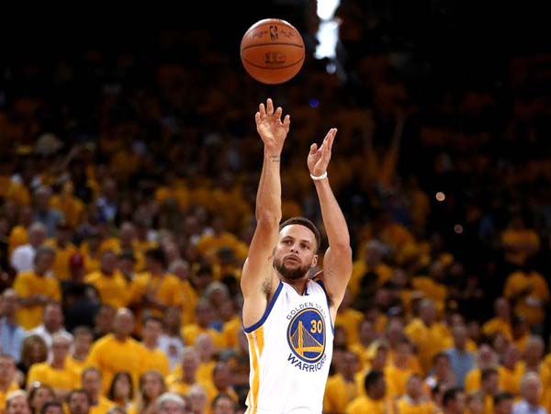
Train like Steph Curry!
Basketball players need to be able to throw with great accuracy!
For one Curry Newman point you will need to complete this workout:
Find something to make a target with (a bucket or a plastic bowl). Roll up some socks and take 6 steps back. See how many sock balls you can throw in your target!

Slide 6
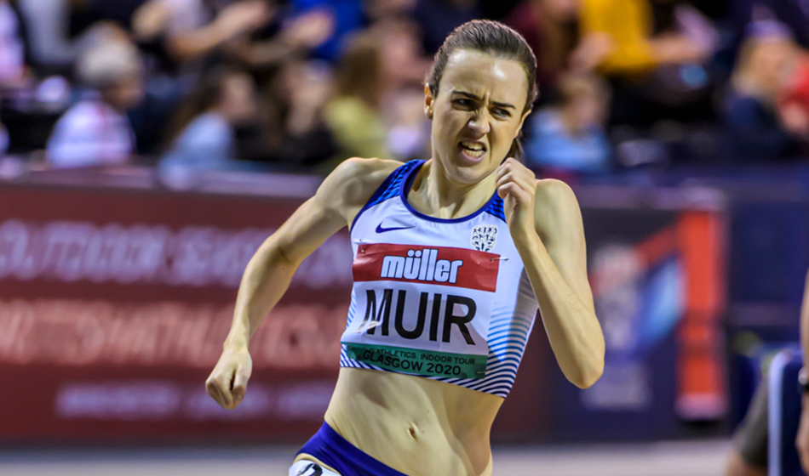
Train like Laura Muir!
Distance runners need to be able to keep their body moving for a long time!
For one Muir Newman point you will need to complete this workout:
Either complete Star Jumps or run continuously without stopping for 3 minutes!

Slide 7
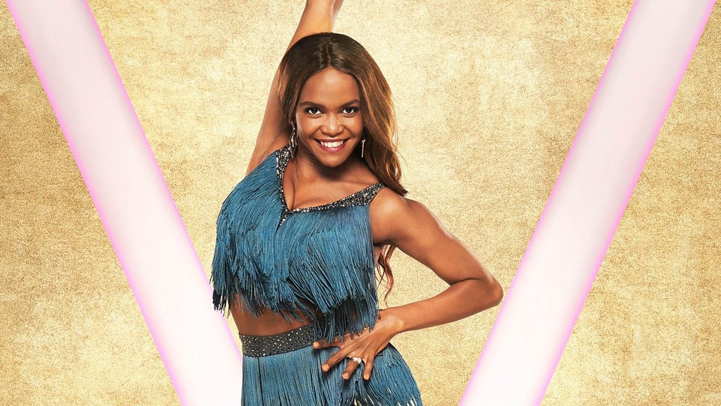
Train like Oti Mabuse!
Dancers need to be able to keep their physically fit and creative!
For one Mabuse Newman point you will need to complete this workout:
Move your body to music without stopping for 1 minute!

