Slide 1

Visio Divina
for primary schools
Jubilee Icon

Slide 2



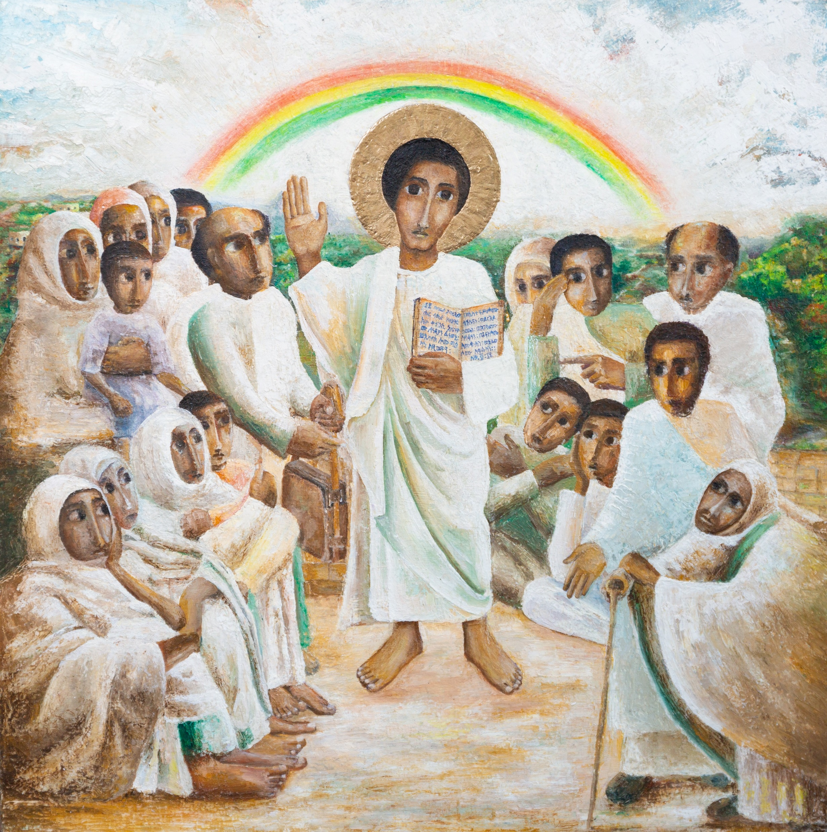
Gather
Lord,
Open our eyes
so that we can see you.
Open our ears
so that we can hear your word.
Open our hearts
so that we can love you
and others more and more.
Amen.

Slide 3

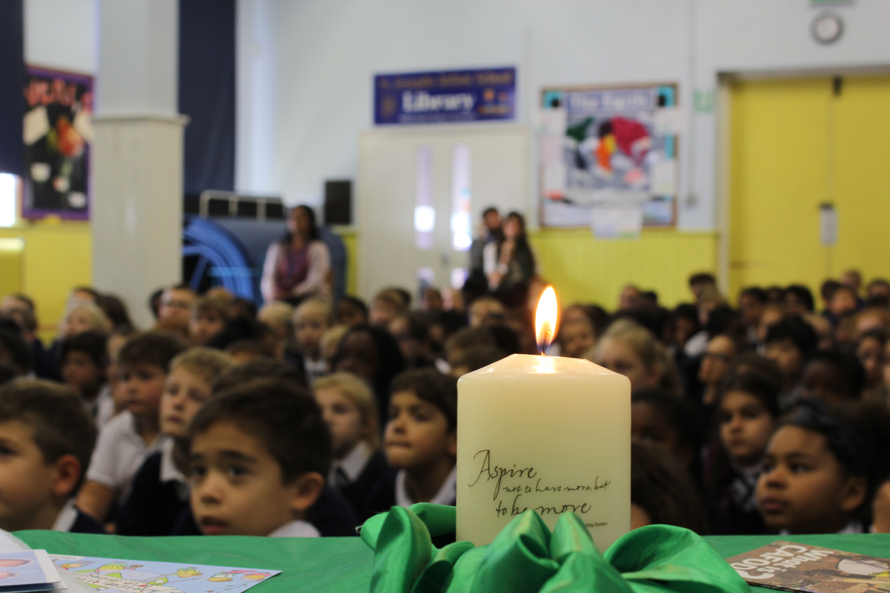
Word
A reading from the Gospel of Luke.
(Luke 4:16-21)

Slide 4
Word
“The Spirit of the Lord is upon me,
because he has chosen me to bring
good news to the poor.
He has sent me to proclaim
liberty to the captives
and recovery of sight to the blind,
to set free the oppressed
and announce that the time has come
when the Lord will save his people.”

Slide 5

Respond
WHO is in the picture?
Notes:
Reflection to read to your children. Play some quiet music. Children to respond to any questions in their own head rather than out loud.
Look at our image. In your own mind, respond to my questions. Who can you see? Who do you think they represent?
Look at Jesus in the centre. Look how he welcomes people to him. We can see him teaching and people listening.
Look how Jesus is looking directly towards you. What is Jesus calling you to do in this year of hope?
You may notice that there are people who are young and old. Some may even be described as vulnerable. Jesus welcomes all.
Do you notice that Jesus is holding scripture. He treasured the words of God. How can you embrace the Word in this year of Jubilee?
In the background, you will see a rainbow. A sign of hope. How will yu spread the hope of Jesus this year?

Slide 6

Go Forth
Think of a way that you will spread the hope of Jesus to all that you meet this year.

Slide 7
Go Forth
Let us pray:
Jesus, our light,
In this Jubilee year,
you remind us of our call to love
our neighbours and to set free those who suffer.
Help us to treat everyone with dignity;
to be fair, forgiving and kind.
All: Guide us on our journey as pilgrims of hope. Amen.

Slide 8


