Slide 1


Slide 2
New Year

Slide 3

New Year

Slide 4






Slide 5

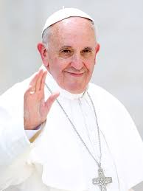
What is particularly special about the year 2025 in the church?

Slide 6

The theme for the 2025 Jubilee Year is an invitation to share the hope of the Christian faith with the world.

Slide 7
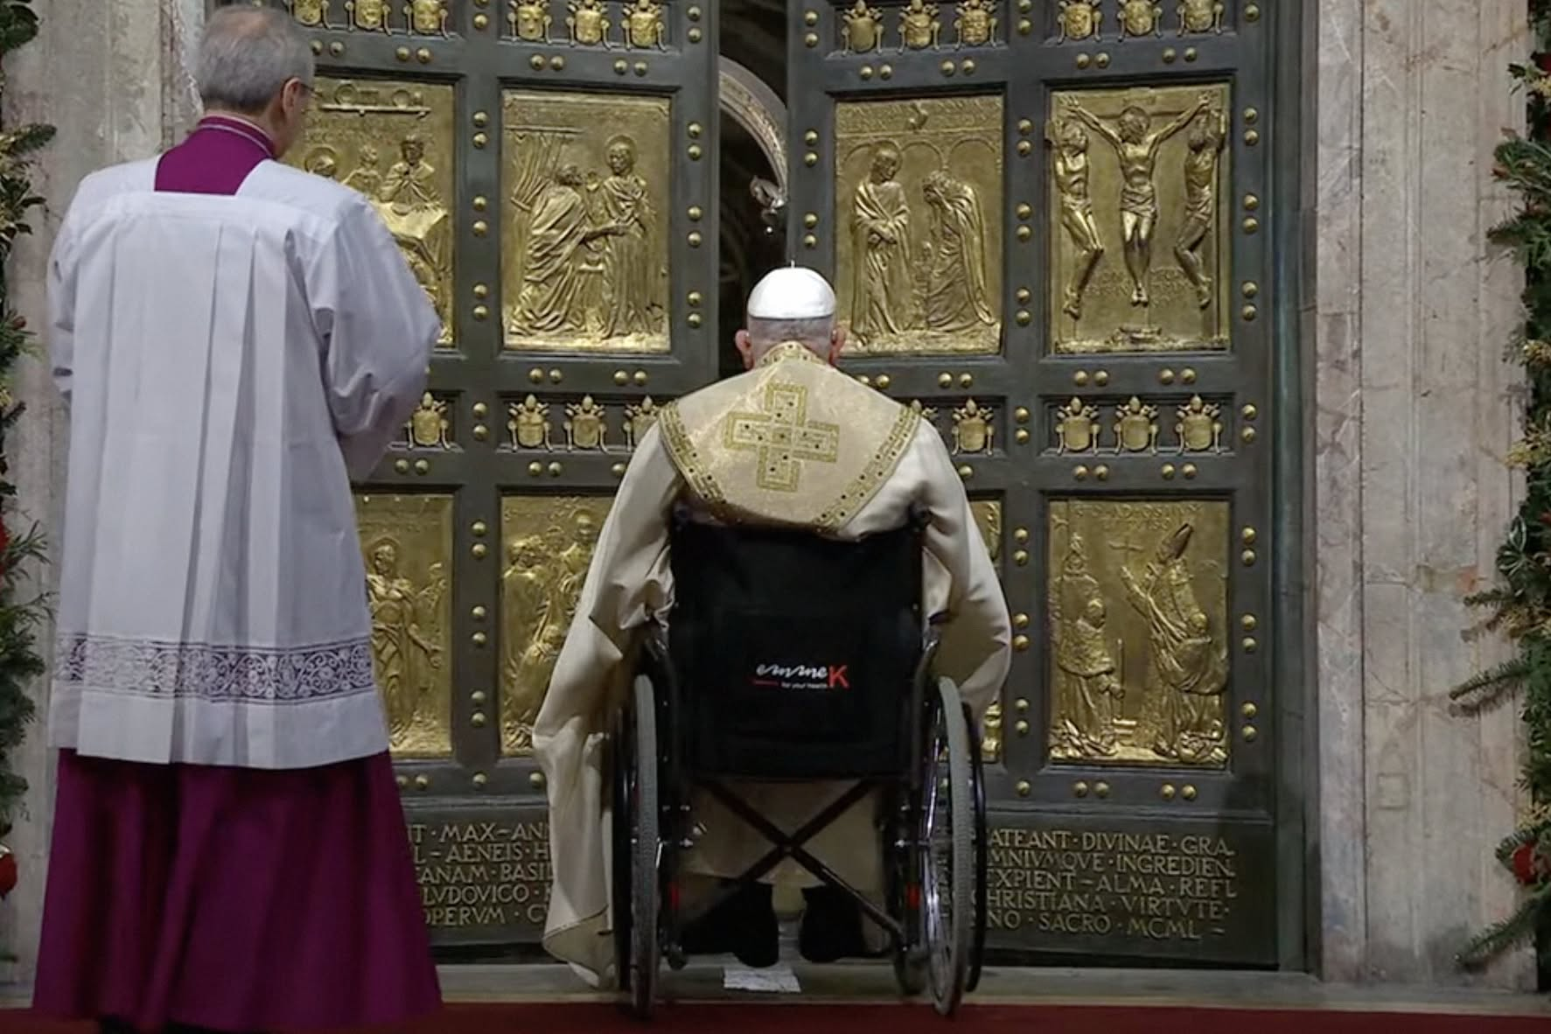

Slide 8

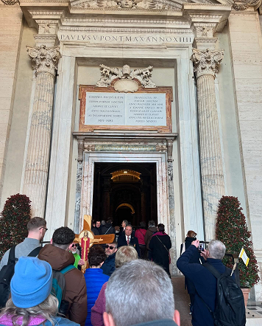


Slide 9


Slide 10
What does this mean for us?

Slide 11


